Slide 1
Lecture 3: Data
What it is, where to get it, and factors to consider.
Acknowledgment : Pavlos Protopapas, Kevin Rader, and Chris Tanner

Slide 2
Python regular expressions

Slide 3
Regular Expressions
Regular expressions are a powerful string manipulation tool
All modern languages have similar library packages for regular expressions
Use regular expressions to:
Search a string (search and match)
Replace parts of a string (sub)
Break strings into smaller pieces (split)

Slide 4
Python’s Regular Expression Syntax
Most characters match themselves
The regular expression “test” matches the string ‘test’, and only that string
[x] matches any one of a list of characters
“[abc]” matches ‘a’,‘b’,or ‘c’
[^x] matches any one character that is not included in x
“[^abc]” matches any single character except ‘a’,’b’,or ‘c’

Slide 5
Python’s Regular Expression Syntax
“.” matches any single character
Parentheses can be used for grouping
“(abc)+” matches ’abc’, ‘abcabc’, ‘abcabcabc’, etc.
x|y matches x or y
“this|that” matches ‘this’ and ‘that’, but not ‘thisthat’.

Slide 6
Python’sRegular Expression Syntax
x* matches zero or more x’s
“a*” matches ’’, ’a’, ’aa’, etc.
x+ matches one or more x’s
“a+” matches ’a’,’aa’,’aaa’, etc.
x? matches zero or one x’s
“a?” matches ’’ or ’a’
x{m, n} matches i x‘s, where m<i< n
“a{2,3}” matches ’aa’ or ’aaa’

Slide 7
Regular Expression Syntax
“\d” matches any digit; “\D” any non-digit
“\s” matches any whitespace character; “\S” any non-whitespace character
“\w” matches any alphanumeric character; “\W” any non-alphanumeric character
“^” matches the beginning of the string; “$” the end of the string
“\b” matches a word boundary; “\B” matches a character that is not a word boundary

Slide 8
Search and Match
The two basic functions are re.search and re.match
Search looks for a pattern anywhere in a string
Match looks for a match staring at the beginning
Both return None (logical false) if the pattern isn’t found and a “match object” instance if it is
>>> import re
>>> pat = "a*b”
>>> re.search(pat,"fooaaabcde")
<_sre.SRE_Match object at 0x809c0>
>>> re.match(pat,"fooaaabcde")
>>>

Slide 9
Q: What’s a match object?
A: an instance of the match class with the details of the match result
>>> r1 = re.search("a*b","fooaaabcde")
>>> r1.group() # group returns string matched
'aaab'
>>> r1.start() # index of the match start
3
>>> r1.end() # index of the match end
7
>>> r1.span() # tuple of (start, end)
(3, 7)

Slide 10
What got matched?
Here’s a pattern to match simple email addresses
\w+@(\w+\.)+(com|org|net|edu)
>>> pat1 = "\w+@(\w+\.)+(com|org|net|edu)"
>>> r1 = re.match(pat,"finin@cs.umbc.edu")
>>> r1.group()
'finin@cs.umbc.edu’
We might want to extract the pattern parts, like the email name and host

Slide 11
What got matched?
We can put parentheses around groups we want to be able to reference
>>> pat2 = "(\w+)@((\w+\.)+(com|org|net|edu))"
>>> r2 = re.match(pat2,"finin@cs.umbc.edu")
>>> r2.group(1)
'finin'
>>> r2.group(2)
'cs.umbc.edu'
>>> r2.groups()
r2.groups()
('finin', 'cs.umbc.edu', 'umbc.', 'edu’)
Note that the ‘groups’ are numbered in a preorder traversal of the forest

Slide 12
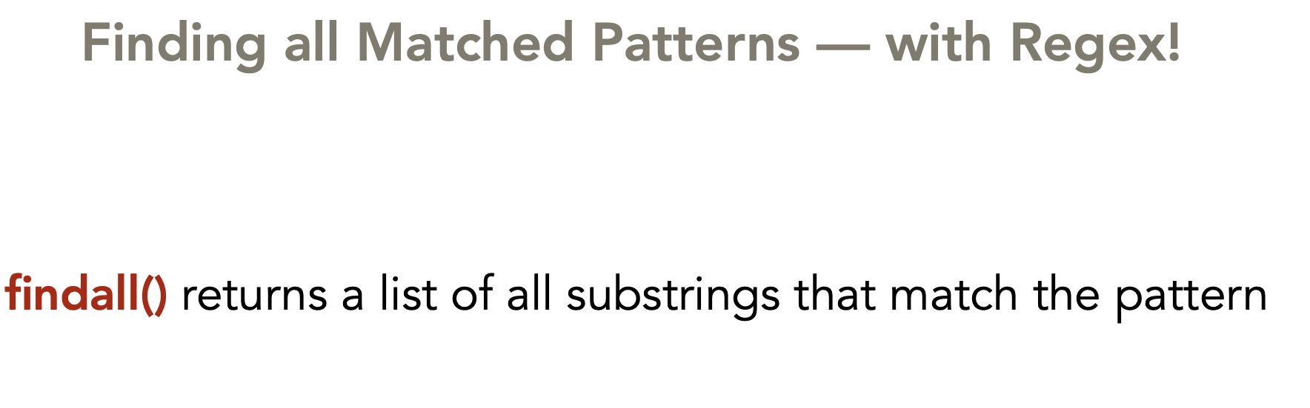
Regular Expressions

Slide 13
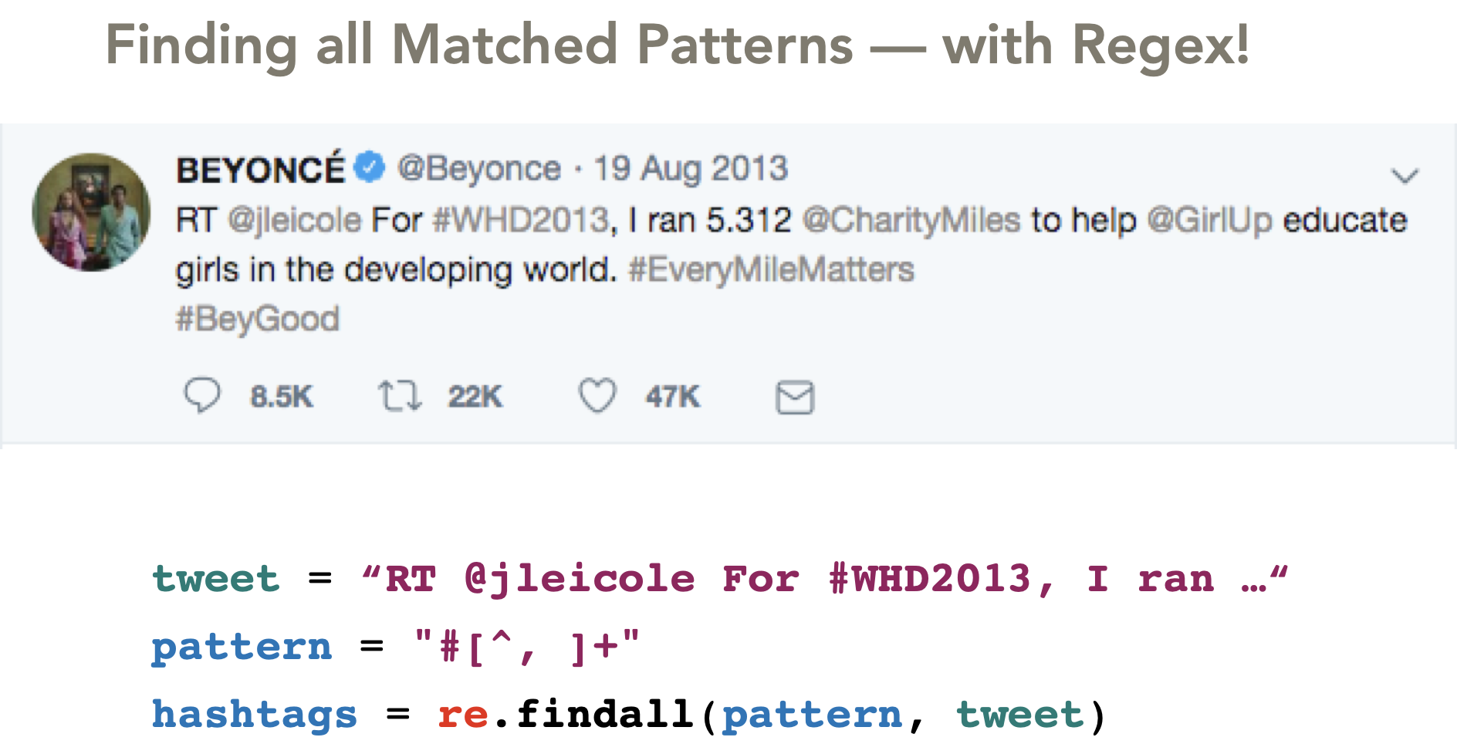
Regular Expressions

Slide 14
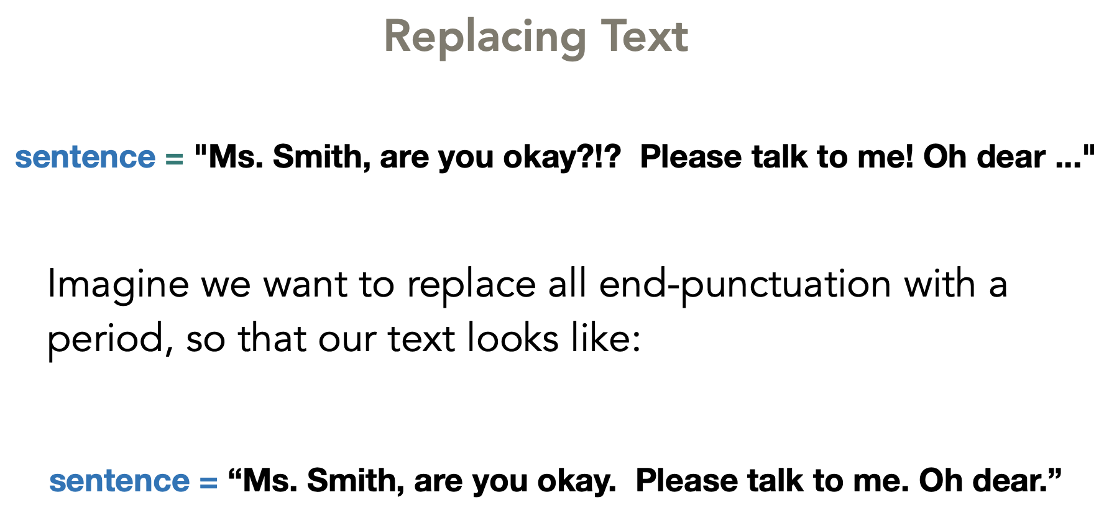
Regular Expressions

Slide 15
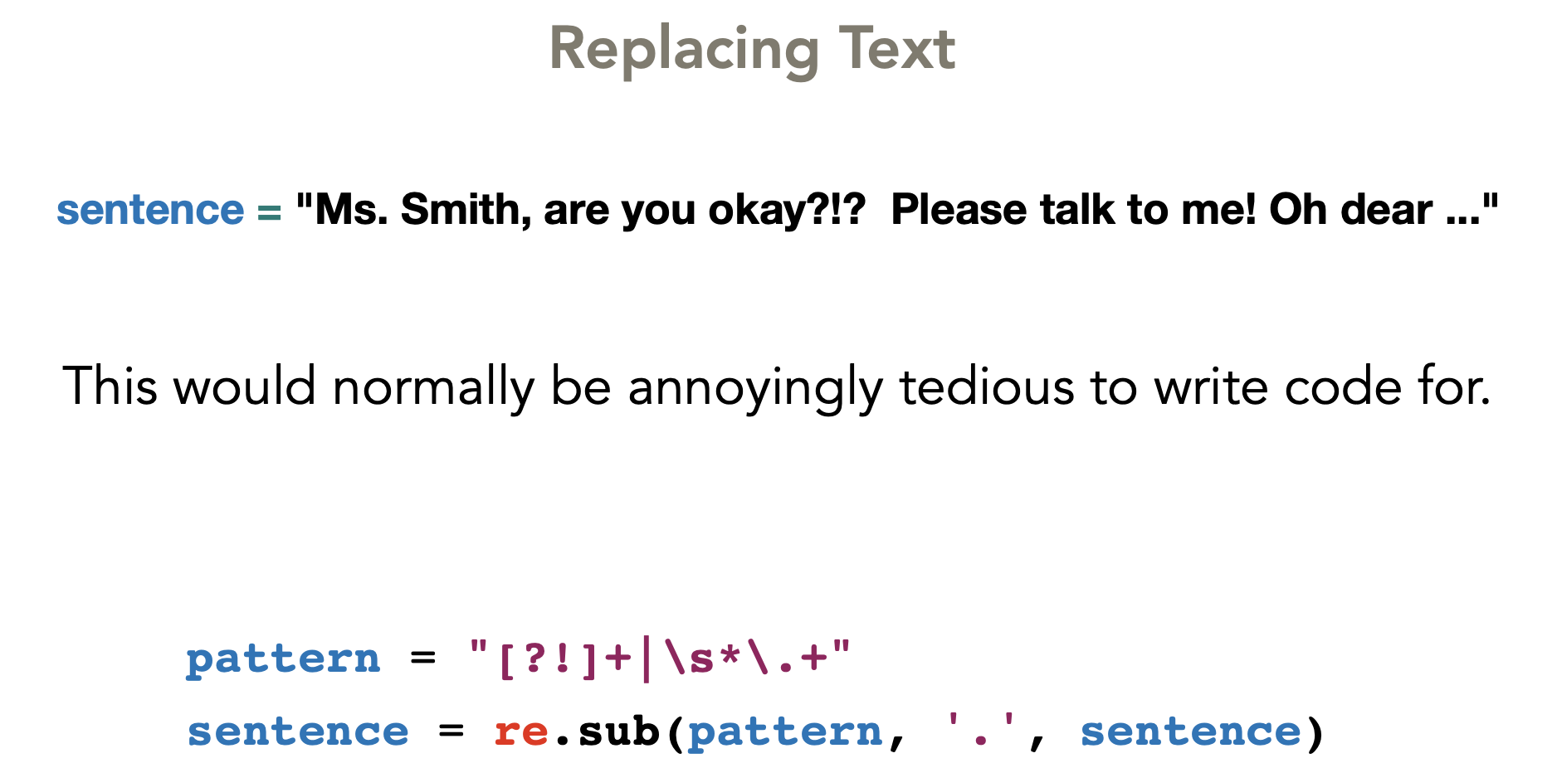
Regular Expressions

Slide 16
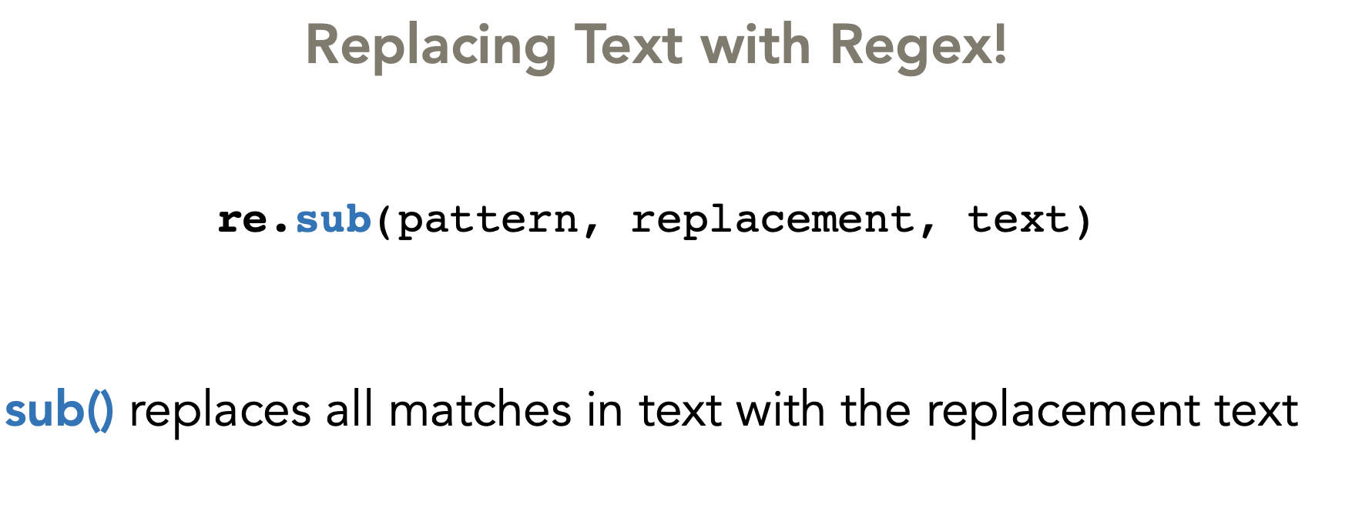
Regular Expressions

Slide 17
Regular Expressions
Patterns work by matching on:
specific characters (e.g., ‘z’) or
large categories of characters (e.g., all lowercased letters or all digits)

Slide 18
Regular Expressions
WORKED EXAMPLE:
“Code didn't work, no idea why…”

Slide 19
Regular Expressions
Specific Characters
text = “Code didn't work, no idea why…”
pattern = ‘a’
re.findall(pattern, text)
Output: a

Slide 20
Regular Expressions
Specific Characters
text = “Code didn't work, no idea why…”
pattern = ‘[aeiouy]’
re.findall(pattern, text)
The [ ] brackets denote “any of these characters”
Output: ['o', 'e', 'i', 'o', 'o', 'i', 'e', 'a', 'y']

Slide 21
Regular Expressions
Specific Characters
text = “Code didn't work, no idea why…”
pattern = ‘[a-z]’
re.findall(pattern, text)
The [ ] brackets denote “any of these characters”
Output: [‘o', 'd', 'e', 'd', 'i', 'd', 'n', 't', 'w', 'o', 'r', 'k', 'n’, 'o', 'i', 'd', 'e', 'a', 'w', 'h', 'y']

Slide 22
Regular Expressions
Specific Characters
text = “Code didn't work, no idea why…”
pattern = ‘[a-zA-Z]’
re.findall(pattern, text)
The [ ] brackets denote “any of these characters”
Output: ['C', 'o', 'd', 'e', 'd', 'i', 'd', 'n', 't', 'w', 'o', 'r', 'k’, 'n', 'o', 'i', 'd', 'e', 'a', 'w', 'h', 'y']

Slide 23
Regular Expressions
Repeated Characters
text = “Code didn't work, no idea why…”
pattern = ‘[a-zA-Z]+’
re.findall(pattern, text)
The + sign means 1 or more occurrences must appear (greedy approach of matching)
Output: ['Code', 'didn', 't', 'work', 'no', 'idea', 'why']

Slide 24
Regular Expressions
Repeated Characters
text = “Code didn't work, no idea why…”
pattern = ‘[a-zA-Z]*’
re.findall(pattern, text)
The * sign means 0 or more occurrences must appear
(greedy approach of matching)
Output: ['Code', '', 'didn', '', 't', '', 'work', '', '', 'no', ’’, 'idea’,'', 'why’, ’’ , ’’ , ’’ , ‘’]

Slide 25
Regular Expressions
Repeated Characters
Instead of matching on 0 or more or 1 or more occurrences, you can also specify an exact number of occurrences N with {N}

Slide 26
Regular Expressions
text = “555-123-1234, 33-555-123-5678”
pattern = ‘\d{3}-\d{3}-\d{4}’
re.findall(pattern, text)
\d{3} means exactly 3 single-digits in a row
Output: ['555-123-1234', '555-123-5678']

Slide 27
Regular Expressions
text = “555-123-1234, 33-555-123-5678”
pattern = ‘\d{1,3}-\d{3}-\d{3}-\d{4}’
re.findall(pattern, text)
What do you think this matches?

Slide 28
Regular Expressions
text = “555-123-1234, 33-555-123-5678”
pattern = ‘\d{1,3}-\d{3}-\d{3}-\d{4}’
re.findall(pattern, text)
Output: [‘33-555-123-5678']

Slide 29
Regular Expressions
RegEx Syntax
\w Any alphanumeric character and underscore, equivalent to [a-zA-Z0-9_]
\s Matches any whitespace (spaces, tabs, line breaks)
\d Matches any digit character, equivalent to [0-9]

Slide 30
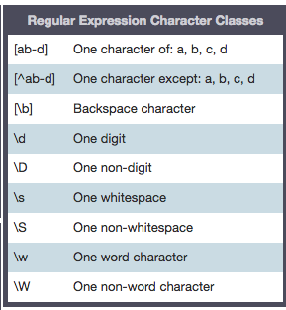
RegEx Syntax

Slide 31
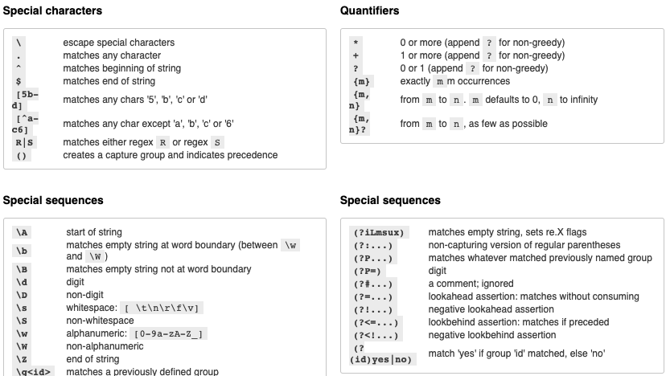
https://pythex.org/

